Slide 1


How to Write An Excellent Project Report
LSGI535-Spatial Data Analysis and Mining
LSGI3244A-Spatial Analysis
Xinghua (Patrick) Cheng, Xiaolin Zhu
Dept. of Land Surveying and Geo-Informatics
The Hong Kong Polytechnic University
20 April 2021

Slide 2
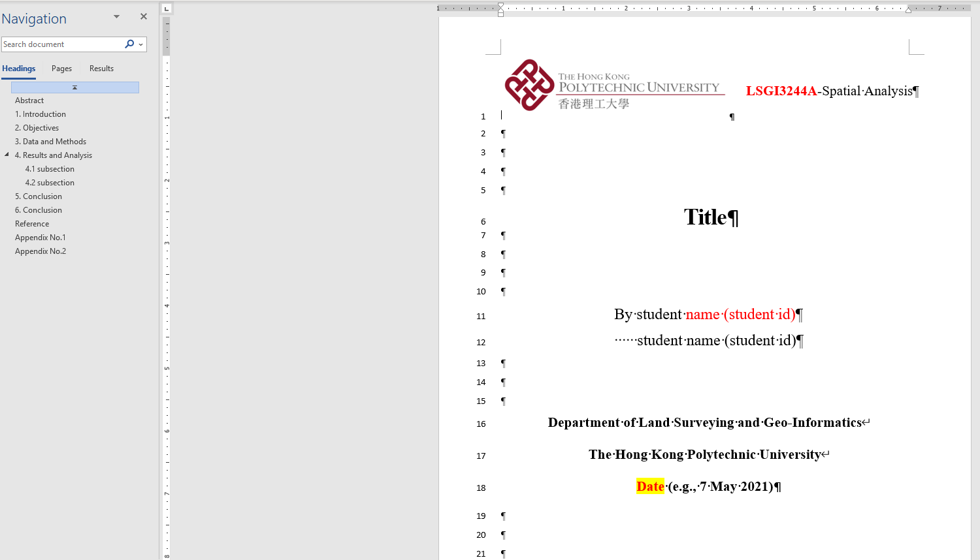
What is the structure of an excellent report?
Title Page
Abstract
Introduction
Data and Methods
Results & Analysis
Discussion (if any)
Conclusion
Reference
Appendices (if any)
The template has been uploaded to the Black Board

Slide 3
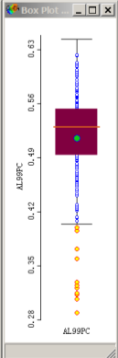
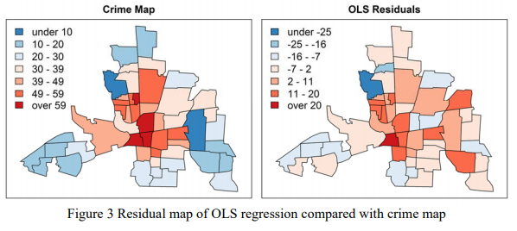
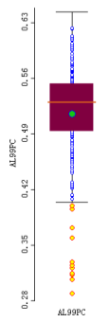
Generate high quality pictures
As shown in Figure 3, the residual map shows patterns of spatial autocorrelation, but is weaker than the crime map.

Slide 4
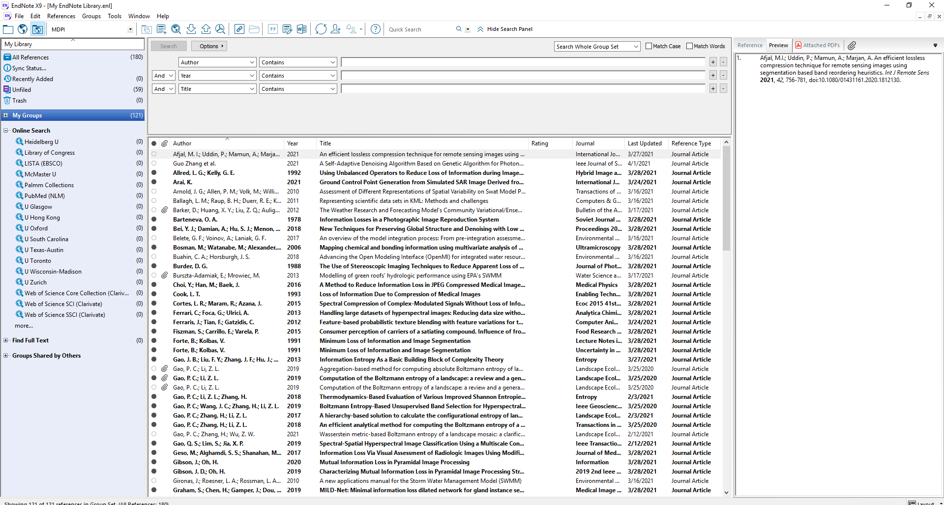
Manage your bibliography
https://www.lib.polyu.edu.hk/research-support/tools/refmanagementtools/download-endnote

Slide 5
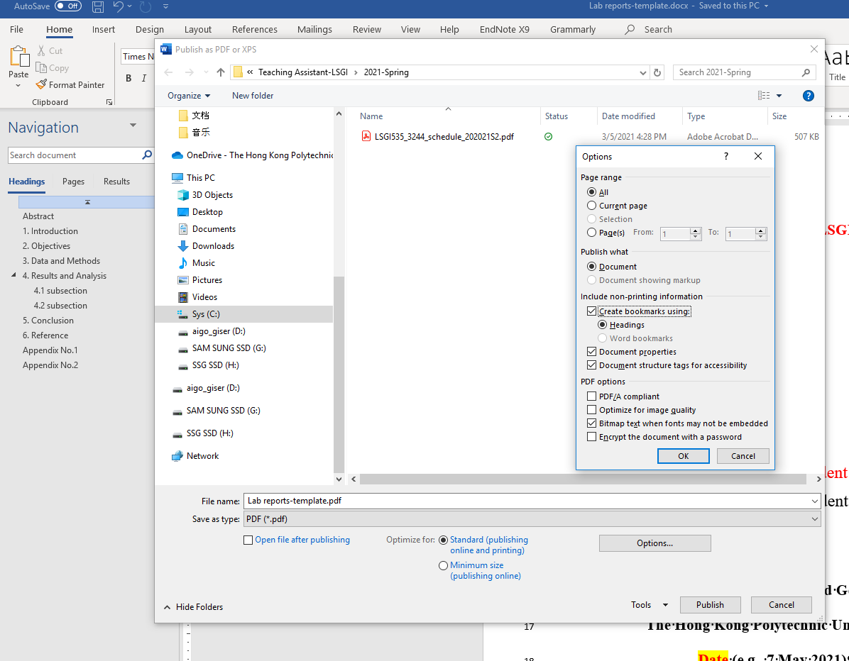
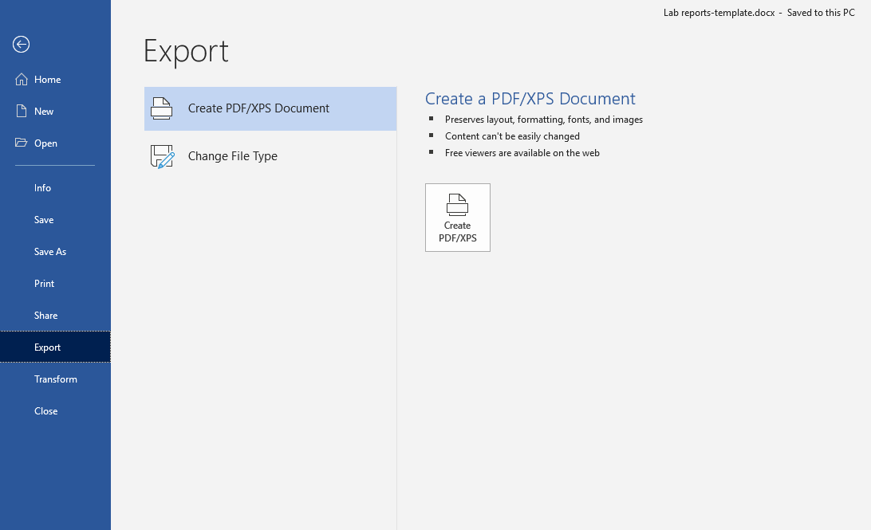
Convert Microsoft Word files to PDF documents
Left Click

